Slide 1


Department of CSE
Cloud & devops (EPAM)
21cs3019aa
Topic:
IP subnetting
Session - 1

Slide 2
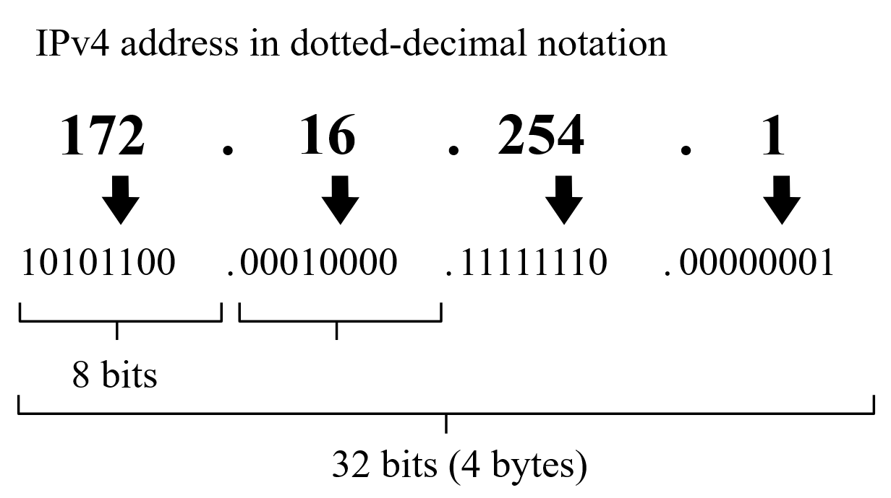
IP Address

Slide 3
Analyze Subnetting and Addressing Needs
Determining the Number of Subnets
Determining the Number of Hosts per Subnet
One Size Subnet Fits All—Or Not

Slide 4
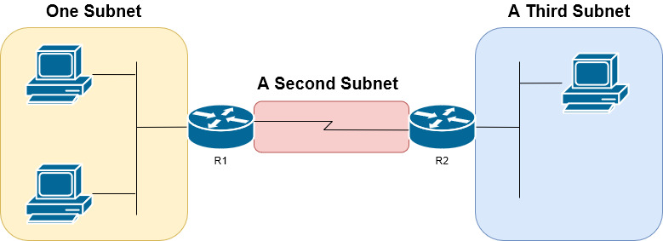
Subnetting rules
IP addressing rules group addresses into groups called subnets. The rules are as follows:
Addresses in the same subnet are not separated by a router.
Addresses in different subnets are separated by at least one router.

Slide 5
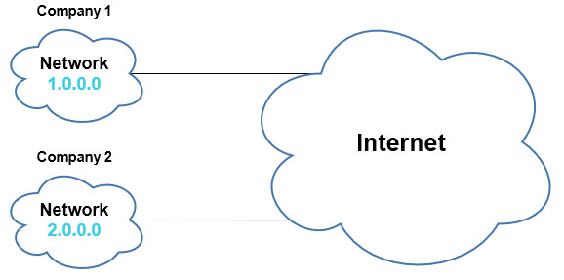
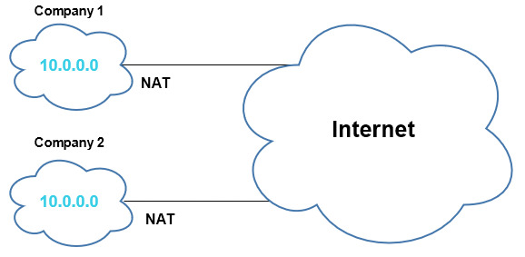
Public and Private Networks
PUBLIC NETWORKS
Private NETWORKS

Slide 6
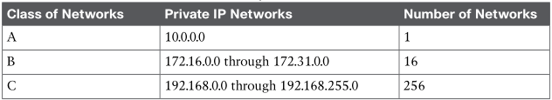
Private Networks (RFC 1918)
Will never be assigned to an organization as a public IP network
Can be used by organizations that will use NAT when sending packets into the Internet
Can also be used by organizations that never need to send packets into the Internet

Slide 7
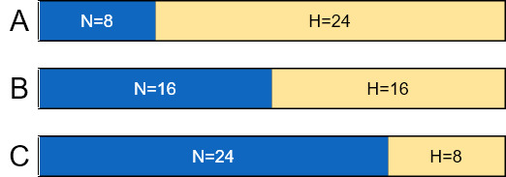
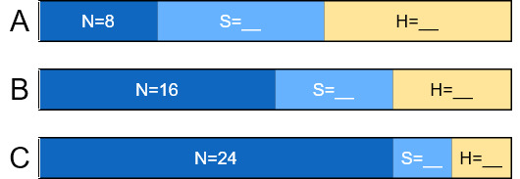
Choose the Mask
Classful IP Networks Before Subnetting
Borrowing Host Bits to Create Subnet Bits
For example, we need to create 200 subnets with 200 hosts per subnet

Slide 8
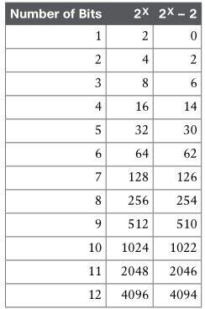
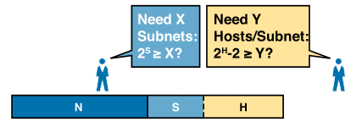
Choose the Mask
Borrowing Enough Subnet and Host Bits
Powers of 2 Reference for Designing Masks

Slide 9

Masks and Mask Formats
11111111.11111111.11111111.0000000
255.255.255.0
/24

Slide 10
Quiz
1.Host A is a PC, connected to switch SW1 and assigned to VLAN 1. Which of the following are typically assigned an IP address in the same subnet as host A? (Select two answers)
A. The local router’s WAN interface
B. The local router’s LAN interface
C. All other hosts attached to the same switch
D. Other hosts attached to the same switch and also in VLAN 1
2. Which of the following are private IP networks? (Select two answers.)
A. 172.31.0.0
B. 172.32.0.0
C. 192.168.255.0
D. 192.1.168.0
E. 11.0.0.0
3. Which of the following are public IP networks? (Select three answers.)
A. 9.0.0.0
B. 172.30.0.0
C. 192.168.255.0
D. 192.1.168.0
E. 1.0.0.0

Slide 11
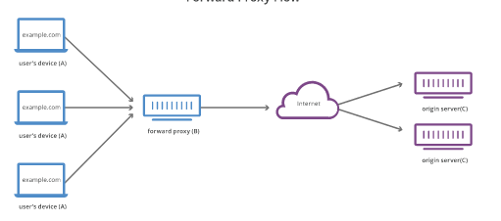
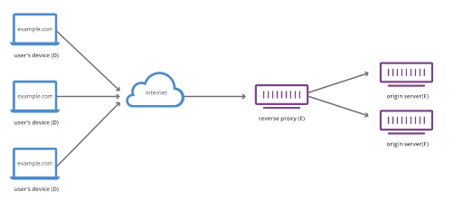
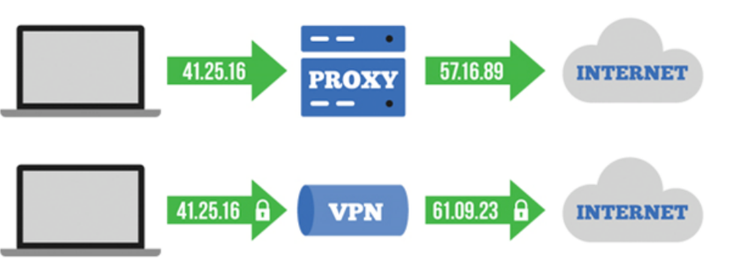
Proxy, Reverse Proxy, VPN

Slide 12
Web Servers
Xampp
Apache Tomcat
NGINX
Apache HTTPS Server
Etc.

Slide 13
Types of DB
Relational-Structured: SQL
Tables
Non-Relational- Unstructured :No SQL
Document Types: Mango DB :Uber
Key- Value pair: Redis DB
Wide Column: Cassandra Ex: NETFLIX
Graph SQL

Slide 14
Storage Fundamentals
File Storage :
EFS- Linux OS, NFS (N/w File System) Protocol
FSx- Windows, SMB (Server Message Block) Protocol
Block Storage: EBS
Object Storage : S3
Storage Types:
DAS – Direct Attached Storage
NAS – N/W Attached Storage
SAN – Storage Area N/w

Slide 15
Thank you

